Slide 1

SmartCast
An Incentive Compatible Consensus Protocol using Smart Contracts
Abhiram Kothapalli
Andrew Miller
Nikita Borisov
Notes:
Motivation,
Incentives
High level system
Init, protocol execution, payouts disposed (not mention dolev strong)
Utility function
BAR equilibruim
Overall Theme:
hand drawn greek
space -> retro, flat art
pixel art
polygonal landscapes
shape people
Shapes (bold color scheme)
Retro comic
Xkcd style
Ink art
Color Scheme: Black on white
Color highlight:
Font: Same as website, reading book font
Script:
My name is Abhiram Kothapalli and today I will be presenting SmartCast, An incentivized consensus protocol using smart contracts

Slide 2

We want our own cryptocurrency, ClubCoin
Notes:
Story
Club that want’s to use it’s own currency(?)
Participants talking about their requirements with text bubbles
Script:
Imagine we have a group that wants to create their own cryptocurrency, ClubCoin

Slide 3
And it’s reliable
It’s hard to cheat the system
We can use a Blockchain or write a Smart Contract
Notes:
Option 1 (Blockchain):
Pro: reliable, hard to cheat the system
Con: Expensive, privacy not maintained
Graphic: Participants envision a blockchain in collective speech bubble after someone suggests
Someone says it’s too expensive
Script:
An immediate and obvious choice would be to use a blockchain or write a smart contract
Benefits: hard to cheat the system reliable

Slide 4
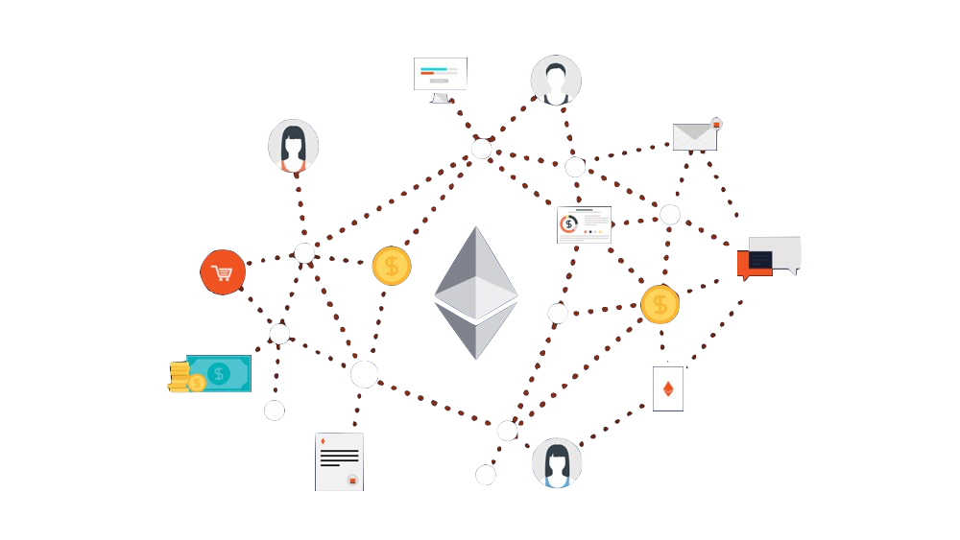
Sample Ethereum Transaction costs $0.07
But it’s too expensive
Notes:
Story
Club that want’s to use it’s own currency(?)
Participants talking about their requirements with text bubbles
Script:
Cons: but it’s too expensive

Slide 5
How about we try a classic consensus protocol instead
Notes:
Option 2 (Consensus Protocol):
Pro: Cheap, control which nodes can participate in consensus
Con: Cannot tolerate byzantine nodes, rational nodes (nodes that will attempt to maximize their own rewards), no security guarantees
Graphic: Participants envision consensus protocol after someone suggests it
Someone says it’s to unsecure
Script:
So let’s instead try a classic consensus protocol

Slide 6
Many algorithms have been explored in the literature
It’s much cheaper
Notes:
Option 2 (Consensus Protocol):
Pro: Cheap, control which nodes can participate in consensus
Con: Cannot tolerate byzantine nodes, rational nodes (nodes that will attempt to maximize their own rewards), no security guarantees
Graphic: Participants envision consensus protocol after someone suggests it
Someone says it’s to unsecure
Script:
Benefits: control who gets to participate, cheaper, many algorithms in the literature

Slide 7

Nodes could lie about their messages
Or not send them at all
Why would nodes even want to do stuff for us?
But this can’t tolerate nearly as many node behaviors
Notes:
Option 2 (Consensus Protocol):
Pro: Cheap, control which nodes can participate in consensus
Con: Cannot tolerate byzantine nodes, rational nodes (nodes that will attempt to maximize their own rewards), no security guarantees
Graphic: Participants envision consensus protocol after someone suggests it
Someone says it’s to unsecure
Nodes could fail to send messages: many protocols assume that only small subset
The big difficulty of bringing consensus protocols to rational setting: many assume some fraction of honest
Contrasted with the blockchain people are incentivized to doit correctly
Script:
Cons: Cannot tolerate as many node behaviors: lie about messages, not send messages, why would nodes even want to do stuff
This leads us to the core question, how can we get rational nodes to do stuff correctly in a consensus protocol

Slide 8
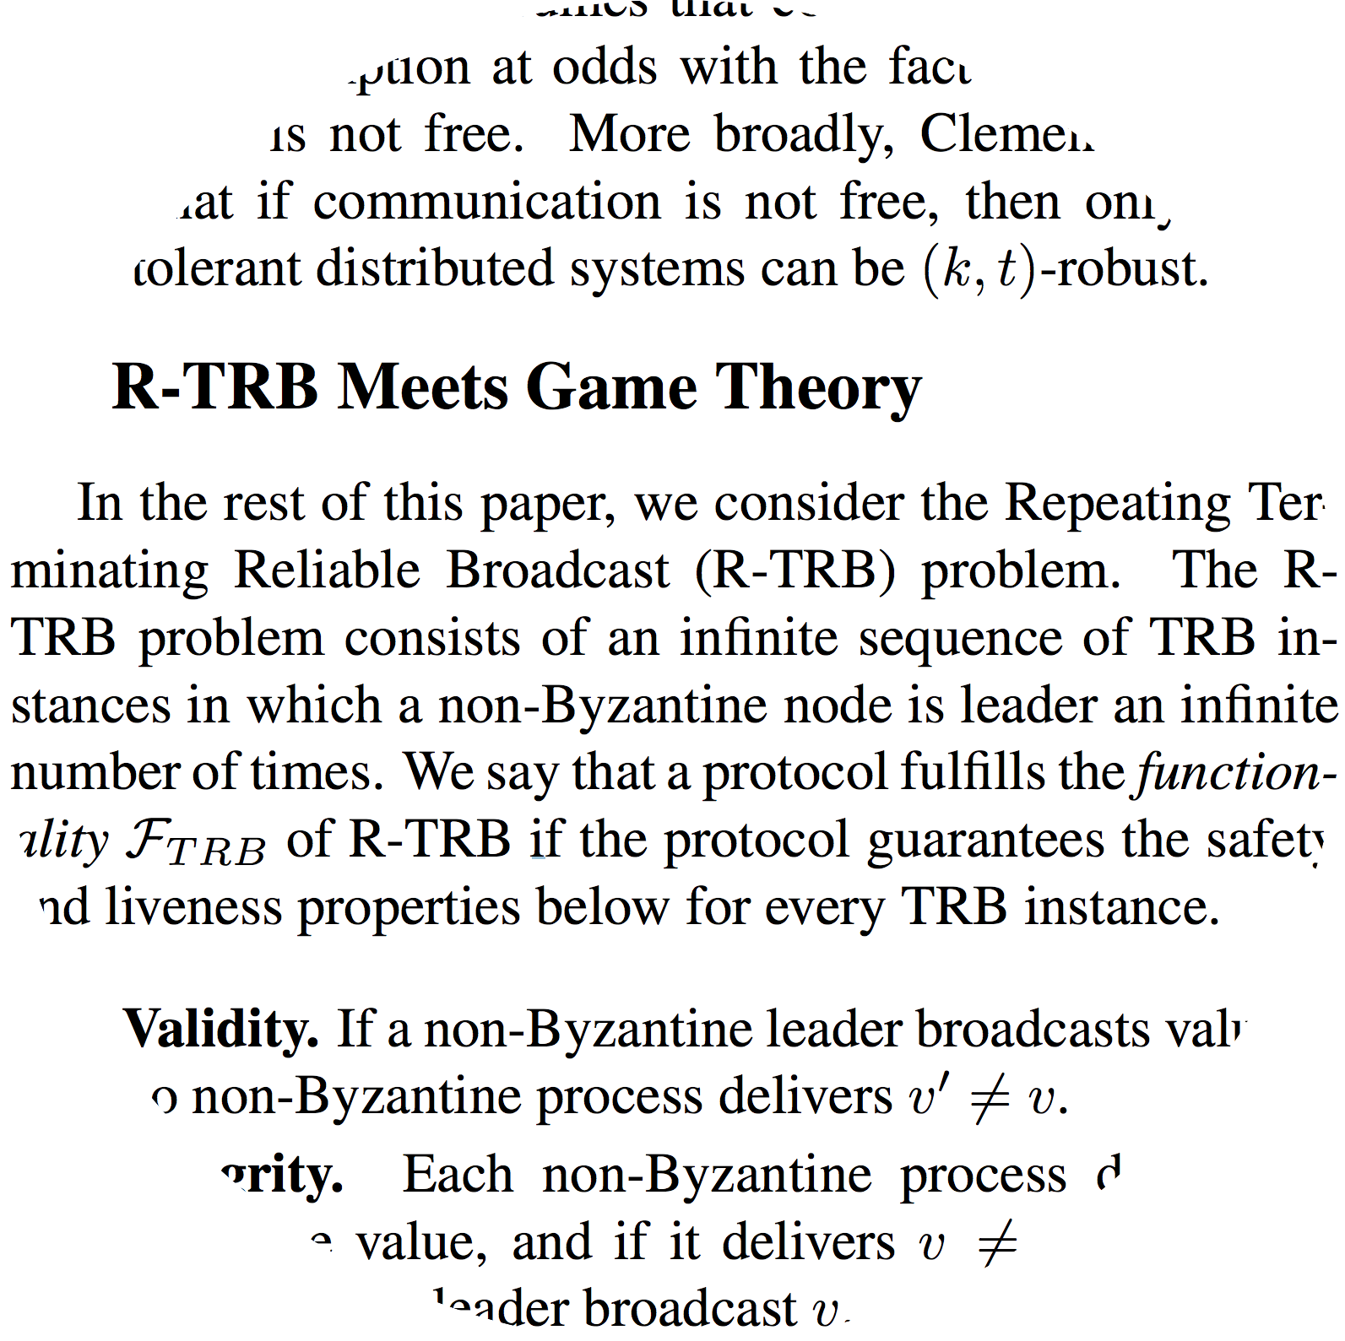
Notes:
Define here that rational means nodes that want to maximize their own profits
Why hasn’t this been done before
There are lines of work in distributed systems that consider rational participants
But...Artificial ways of thinking of risk reward model
For example in BAR primer
Utility is is implicitly gained from the protocol is completed correctly
Protocol runs for infinite rounds
Graphic: Bar primer screenshot which zoom bubbles showing two quotes (shadow not circle)
Entire line of reasoning trying to explain why nodes would want to do stuff for us
Script:
This has been attempted in the past but has many unrealistic caveats: For example one paper assumes there are infinite rounds

Slide 9
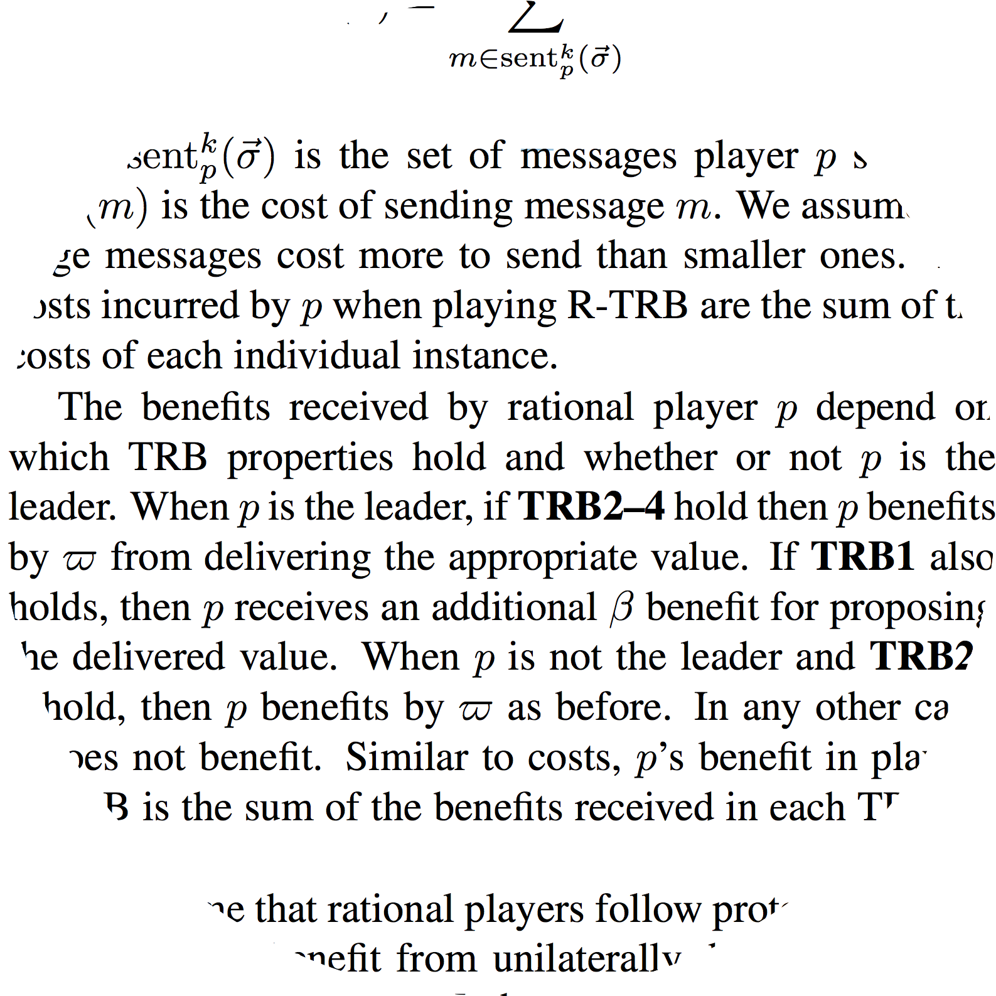
Notes:
Why hasn’t this been done before
There are lines of work in distributed systems that consider rational participants
But...Artificial ways of thinking of risk reward model
For example in BAR primer
Utility is is implicitly gained from the protocol is completed correctly
Protocol runs for infinite rounds
Graphic: Bar primer screenshot which zoom bubbles showing two quotes (shadow not circle)
Script:
Other assumptions include: benefits depend on if the protocol executes correctly,
this is not the case, esp in bitcoin: nodes will attempt to do anything to maximize their winnings

Slide 10
We can use that to incentivize our consensus nodes
But Ethereum allows us to define utility concretely
Notes:
Option 2 (Consensus Protocol):
Pro: Cheap, control which nodes can participate in consensus
Con: Cannot tolerate byzantine nodes, rational nodes (nodes that will attempt to maximize their own rewards), no security guarantees
Graphic: Participants envision consensus protocol after someone suggests it
Someone says it’s to unsecure
Script:
So both methods have drawbacks, perhaps we can combine the two to create something that has the best of both worlds
That has some security benefits of ethereum but also inexpensive

Slide 11


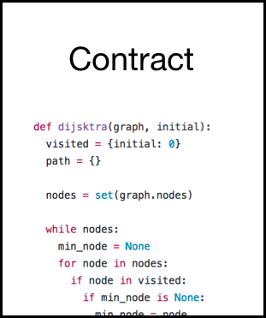

Benefactor
Arbitrary Consensus Protocol
Output
$$p_{r}=p_{r}−θ$$
Reports
Notes:
Smart Contracts -> tangible utility
But with smart contracts we can now model utility in a tangible way
Can use this opportunity to create consensus protocols that are tolerant to rational nodes
Graphic taking a regular consensus protocol and connecting to the ethereum environment
Initialization, Protocol execution, Messages sent in protocol, payouts dispersed
We need to set \theta for that we need to understand rational nodes from a game theory perspective
Depending on field of study: can view this as adding a smart contract layer to maintain incentives, taking the load off blockchain by taking non-critical parts offline
That’s how we can solve incentivization instead of taking previous complicated approach
Graphic: Flow Diagram: consensus protocol pointing to sc
Script:
We can start with a standard consensus protocol
And hook it up to a smart contract living in the ethereum ecosystem
Now some benefactor that needs consensus done can send ethereum to this smart contract
And once the consensus protocol is done, the contract can send ethereum to all the participants to compensate them for their efforts
Suppose there is an Byzantine node that does not follow protocol (for example does not send a message)
Then we would like the smart contract to know and reduce that nodes reward
In this way nodes are incentivized to follow the correct protocol

Slide 12
When and how much do we pay these node?
Notes:
Option 2 (Consensus Protocol):
Pro: Cheap, control which nodes can participate in consensus
Con: Cannot tolerate byzantine nodes, rational nodes (nodes that will attempt to maximize their own rewards), no security guarantees
Graphic: Participants envision consensus protocol after someone suggests it
Someone says it’s to unsecure
Script:
That leads us to the next big topic, Now the key question is: how much do we pay these nodes such that it is just enough to incentivize the nodes to follow the protocol?
How do we pay the appropriate amount conditional ina way that we can make them do what we want

Slide 13
First let’s define a nodes utility
-1
-2
+0
Overall Utility = (Total External Reward) - (Total Bandwidth Costs)
Notes:
A rational servers goal is to maximize its external reward and minimize total bandwidth costs
Script:
First let’s define a nodes utility
For this we will only consider protocols where message cost is the major cost
For every message server sends it will lose utility
And we can compensate this exactly with the payout from the smart contract
Keep in mind under this utility definition, a node will attempt as little messages as possible, not sending a message if allowed, giving us the “lazy” node

Slide 14

Now let’s maximize worst case utility
Knowing this, we have to pick a strategy that maximizes our profit
Other nodes will think just like us, let’s call them Rational
And others will behave arbitrarily, let’s call them Byzantine
Risk-Averse node
Notes:
A rational servers goal is to maximize its external reward and minimize total bandwidth costs
Script:
Given utility, a node will try to maximize it
It will have to pick a strategy to maximize utility while keeping in mind that:
Some nodes will also try to be maximizing their utility: lets call them rational
And others will follow arbitrary strategies: lets call them byzantine
Conservative nodes no repeated participation -> maximizing worst utility -> nodes that are conservative (risk averse) -> no repeated interactions (can amotize the risk) cannot average utility over time (variance is higher so we care more about the worst case) -> Want to assume the worst case makes the most conservative assumption about what the byzantine nodes will do (weakest assumption)
There is a common game theorethic approach to find a nash equilibrium -> no benefit to unilaterally deviationg from the protocol

Slide 15

Now let’s maximize worst case utility
Knowing this, we have to pick a strategy that maximizes our profit
If we consider unilateral deviations, we assume rational nodes follow the protocol
In the worst case Byzantine nodes attack us
Notes:
A rational servers goal is to maximize its external reward and minimize total bandwidth costs
But attempting to maximize over all strategy spaces is too general so lets trim down a bit:
We will assume that our node is attempting to maximize utility in the worst case scenario
In this worst case utility Byzantine nodes don’t follow any strategy, they attack us
Additionally we will assume unilateral deviations, that means we assume that all other rational nodes, just like us, are already following the protocol
Now given these two strategies we must pick a strategy that maximizes profit

Slide 16
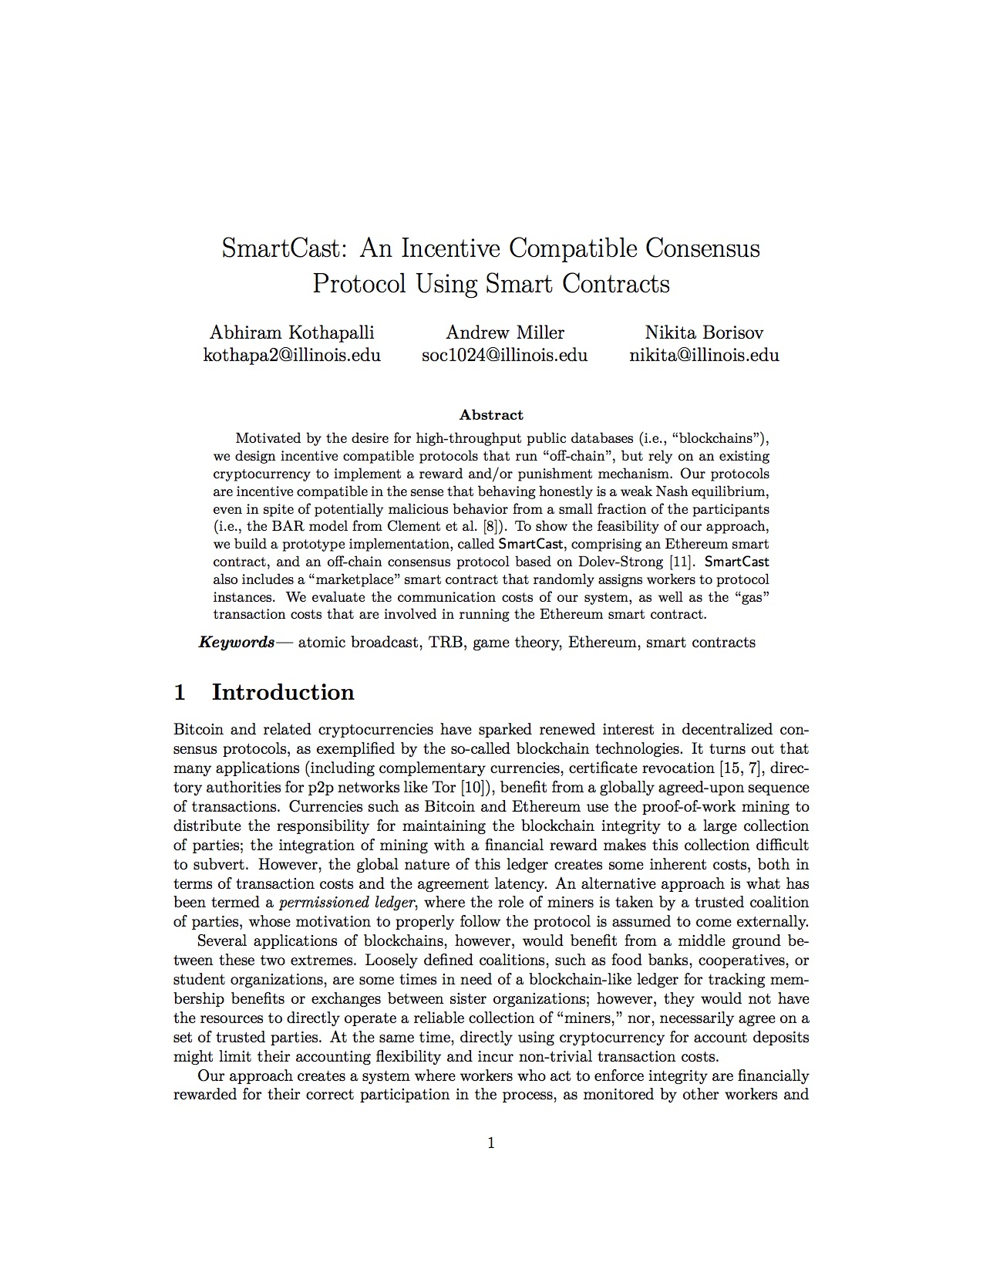
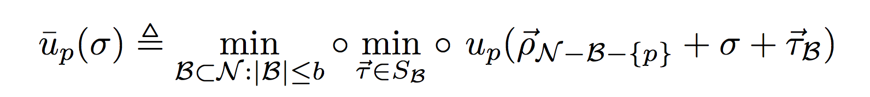
The final utility function
Remaining Nodes follow protocol
P’s strategy
Byzantine Strategies
Worst case selection of Byzantine nodes
Worst case selection of strategies
P’s utility as a function of the networks strategies
Notes:
Utility model
Explain worst case utility model and show min definition
Rational nodes will attempt to follow this
Incentive Compatibility
Following the protocol is a weak nash equilibrium
In other words: Following protocol \pi in the worst case is at least as good as following a deviant protocol unilaterally
Set theta accordingly
Script:
The previous slides can be summarized as above:
P’s utility is a function of all other strategies
Byzantine nodes will chose arbitrary byzantine strategies
P will chose some strategy that maximizes its profit
And remaining nodes will follow the protocol
Now we assume we are trying to maximize worst case and we select the worst possible set of strategies, and the worst possible set of nodes that can run them
GO into box -> go slower
Title: Worst case utiltiy function
Say now at end of util -> goal for protocol is to pick protocol p maximizes worst case utility by picking the protocol

Slide 17
We have to disincentivize the lazy strategy
Notes:
Option 2 (Consensus Protocol):
Pro: Cheap, control which nodes can participate in consensus
Con: Cannot tolerate byzantine nodes, rational nodes (nodes that will attempt to maximize their own rewards), no security guarantees
Graphic: Participants envision consensus protocol after someone suggests it
Someone says it’s to unsecure
Script:
That leads us to the next big topic, Now the key question is: how much do we pay these nodes such that it is just enough to incentivize the nodes to follow the protocol?

Slide 18
SmartBar Protocol Transformer
Impose penalty on nodes that fail to meet message requirements
If node does not receive M bits from another node it can mark it as enemy and report to smart contract
Smart contract can deduct from reward for every marking of enemy
Predictable communication pattern: Each node required to send maximum possible bits M
Node additionally send dummy messages in last round to send M total bits
Notes:
SmartBar Protocol transformer
We create a generic protocol transformer, where message cost is the primary cost
Two key modifications:
Predictable communication pattern
Impose a penalty on nodes that fail to send expected messages
To implement this
Smart contract program
Initialized with endowment (could be deposit)
Initialized with a set of players
Receives report from player within fixed time
Determine reward as a result of report
Note that our definition of enemy only contains not sending enough messages, therefore creating a transformer for msg cost. Future work could be much more general
This blocks general lazy strat because detect
Script:
Now that we have a utility mode we can finally describe a general protocol transformer that converts any protocol with message cost as the main cost into an incentive compatible one
First we need a predictable communication pattern so nodes know exactly how many messages they are supposed to receive
We can easily transform any protocol to fit this specification by sending dummy messages in the last round
Next once we complete all rounds, nodes can report to smart contract which nodes the did not receive all messages form
The smart contract can impose penalties on these nodes
In the paper we prove that after this transformation the worst utility achieved by following the protocol is at least as profitable as deviating

Slide 19
The Selectively Lazy Strategy
It is now more beneficial to randomly withhold some messages
Worst case is now the spiteful strategy. Byzantine nodes act good but mark you as enemy

Slide 20
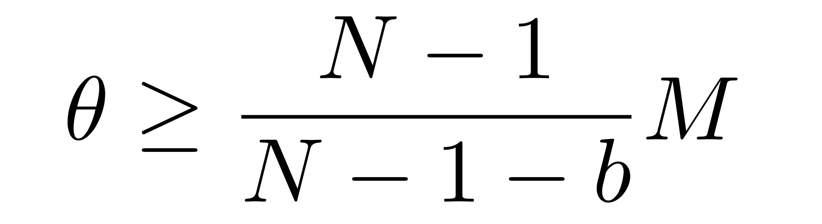
Disincentivizing the selectively lazy strategy
Total number of nodes
Chose the reward to be high enough such that there is no benefit from randomly withholding messages
The more Byzantine nodes we assume, the more we have to compensate nodes
Total number of non-Byzantine nodes
Must be based on message cost
Notes:
Why hasn’t this been done before
There are lines of work in distributed systems that consider rational participants
But...Artificial ways of thinking of risk reward model
For example in BAR primer
Utility is is implicitly gained from the protocol is completed correctly
Protocol runs for infinite rounds
Graphic: Bar primer screenshot which zoom bubbles showing two quotes (shadow not circle)
This doesn’t block selectively lazy -> byzantine node will punish regardless lost cause -> identify byz nodes then increase utility by withholding messages -> -> it suffices to look at worst case (spiteful honest until last point -> report enemy and punish you) there is no way to identify -> if you guess randomly you can save costs given that b is high enough. Chose the reward to be high enough even if random guess there cannot be a benefit. Explain fraction we set this high enough that, even guess wrong some of the time costs more than message costs
Script:
In the paper we prove that this is the cost needed to make dolev strong incentive compativle
Intuitively based on message cost, because we are compensating for that
Theta geq this

Slide 21
We have a general protocol transformer
Let’s try this with Dolev Strong
Notes:
Dolev Strong Case Study
Suppose our club chooses to use Dolev Strong
Dolev-Strong
Dolev strong primer
Nodes can be lazy and therefore break the protocol
Edits for dolev strong
Dolev strong in the overall consensus picture
Padding
2 expected messages can be dummy
Report cost
Setting theta for dolev strong
Script:
Now that we have a completed generalization for how the protocol transformer works, let’s try this with dolev strong

Slide 22


Dolev Strong
R0 : 0, sig_{L}
R1: 0, sig_{L,} sig₁, sig_{2,} sig_{3,} sig₄
R0 : 0, sig_{L}
R1: 0, sig_{L,} sig₁, sig_{2,} sig_{3,} sig₄
v : 0, sig_{L}
R0 : 0, sig_{L}
R1: 0, sig_{L,} sig₁, sig_{2,} sig_{3,} sig₄
Notes:
Run for f + 1 rounds: tolerates f byzantine nodes. Must include signature from honest party, that means message has been sent to all other honest nodes
Case 2 Nodes in diagram
Node cannot lie about a message because requires leader signature
If leader equivocates honest nodes will eventually see all leaders messages and output default value
But rational node knowing this can chose not to send expensive messages. Protocol will still succeed
Not a weak nash equilibrum
Script:
For those of you that are not familiar with the dolev strong protocol, Lets go over a brief overview
We assume binary dolev strong
We will consider the case that we are tolerating 1 byzantine node
Dolev strong is a leadered consensus algorithm. The leader broadcasts a value for all the nodes to register.
All the nodes register the leaders broadcast and verify that leaders signature is on broadcast
All nodes forward messages again, this handles the case where leader is our faulty node and forget to send a message to a node
In the case that one of the followers is faulty and does not broadcast then all nodes still get appropriate values (with the exception of signature 4)
In binary Dolev strong we have to send 2 messages max, one of the requirements is we have to send signed message from leader once to every node (worst case is when leader equivocates)

Slide 23

Cost of Dolev Strong
Worst case = 2 (N - 1) messages per instance
Total bandwidth = 2 (N - 1) * transaction size * K instances
= 2 (16 - 1) * 300 bytes * 10000 instances
= 90 megabytes
Total cost = N * total bandwidth * bandwidth cost
= 16 * 90 megabytes * 0.009 cents / megabyte
= 12.69 cents for 10000 instances
Notes:
Worst case 2 messages to each node node per instance
2 (N - 1) * transaction size
2 (20 -1) * 300 bytes * 1000 rounds = __ kb per node
EC2 Instance cost = xx
Bandwidth costs 0.00009 cents per mb total
Cost 0.0008 per node
Our benefactors have to pay that much
Instance == transaction

Slide 24
Requesters
Marketplace Contract
Workers
Cost (16 nodes) = $1.70
Built in randomized node assignment
Randomized assignment should assign nodes such that not too many nodes are Byzantine
Total Cost (16 nodes) = $1.8269
Cost (16 nodes) = $0.1269
Notes:
The big picture: Marketplace
Animation + requesters/workers
Assumption 1: Randomized assigning of nodes
Randomization is the most expensive part, shuffle even Fisher Yates more expensive than sha3
signature checking, kv store instructions are cheap
Solution could be to trust randomized oracles
Assumption 2: randomization function assigns nodes such that less than b nodes are Byzantine
Script:
Now we can look at the big picture contract, the marketplace contract
Say we have a set of nodes (workers) that want to participate in consensus and a set of requesters who would like consensus for their application
The marketpalce will select a subset of workers and assign them to a smartcast request
We show the feasibility of this by building a marketplace contract that randomly assigns nodes, this prevents attacker from using that info for an attack vector
We assume that this randomization assigns less than b byzantine nodes per protocol
12 cents of communication cost -> need to send 1.7 for contract -> still doing a lot cost here is dominated by contact -> contact is dominated by choosing a set of random nodes (interesting problem -> some cryptographic things are cheap but shuffling is expensive)

Slide 25
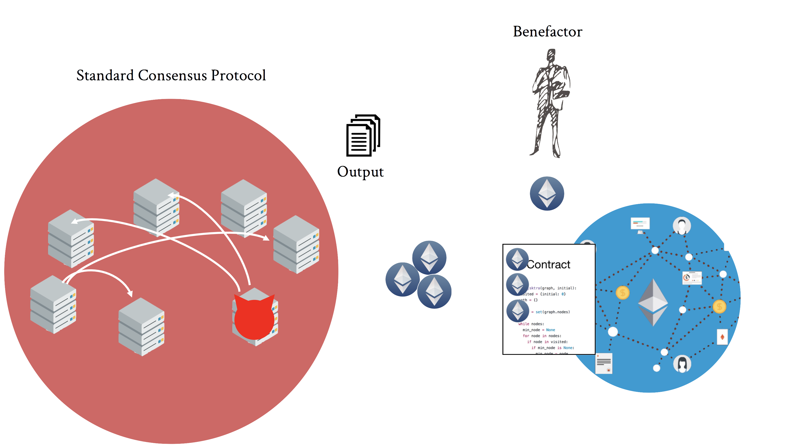
Questions?
Notes:
Script:
So now we have our final solution to build Clubcoin: An incentivized consensus protocol hooked up to a smart contract
Questions?

